Slide 1
JUDGMENT DAY

Slide 2
USING JUDGMENT IN APPRAISAL PRACTICE/REPORTING
Appraisers by nature are very opinionated and assert those opinions in their reports. Their opinions may be purely intuitive statements that are based on their observations, experience, knowledge of the industry, geographical knowledge, analysis of facts, information provided by peers, colleagues and other professionals in the real estate industry.
Judgment is the application of these factors in the decision making process when drawing conclusions that will be stated in the report.
Notes:
We don’t typically work in a large office environment where we have a large group of peers to bounce ideas, problems and issues off each other around the water cooler or coffee pot. For the most part appraisers work in an isolated enviormant. When you work in an islosted environment you are more apt to work through issues and develop an opnion based on the information in front of you. You work to support that opinion and you take ownership in that opinion. Occasionally you’ll pick up the phone and call a peer or send an email, or go to one of the online peer groups and present an issue. But for the most part we work as individuals and we develop individual opinions that are placed and impact the results stated in our reports.

Slide 3
DON’T DO IT!!!!!!!
Notes:
When I first joined the board in January 2018 we were sitting around discussing with Ray Art education Chairman the agenda for the presentations at the Monday night meetings. We did not have a topic for April and believing that our purpose should be to solve real day-to-day problems or issues that appraisers face I suggested to Lou that maybe we should do a presentation on how to calculate the adjustment value for view. Blue apparently has not been in the military because as we all know in the military you never volunteer for anything and I certainly wasn’t volunteering for this however he took it that way and turned and said to me can you have that done by April. After initially taking a look at what would be involved in doing a two hour presentation on view and came to the conclusion that a lot of information stated in the report including the view adjustment relies on judgment. So I changed the topic of this presentation from how to calculate an adjustment on view to using judgment in your report. What I found was this was also a very difficult topic to develop and discuss a presentation on. Several people said don’t it will be to confrontational so with that said I am going to rely on Lou to moderate and facilitate this so that there are discussions don’t get too far off base but yet still give us a good representation of what your peers may be thinking with respect to this topic.

Slide 4
SOME SAY THAT APPRAISAL PRACTICE IS:
A combination of Art and Science
Others say it is a Science applied artfully
Science is a testable explanation of your knowledge.
Not all components of appraisal practice can meet the standards typically associated with the definition of science. Science must generate a testable result that that can be reproduced with good Quality Assurance/Quality Control (QA/QC).
Therefore, a portion of appraisal practice lie outside what is considered science and fall into the category of theorem, judgment, and the development of reasonable conclusions based upon observations.
Notes:
A testable explanation of your knowledge must show that it can be reproduced and result in the same conclusion or value by an independent third party. That becomes very difficult if any two individuals use their independent knowledge in any part of the equation – the results will differ.
Part of my background was that I spent 23 years with the United States Environmental Protection Agency is an environmental scientist, civil investigator, and law enforcement officer. I relied upon good science in order to support my conclusions with respect to corporations that violated federal environmental rules. Therefore when I compare my background to appraisal practice I do see some science in appraisal practice but also a reliance on using judgment and conclusions based upon relevant factors.

Slide 5
Where an appraiser is required or given the option to use judgment according to USPAP
Ethics Rule
“USPAP requires an appraiser to use good judgment”
Competency Rule/Scope of Work
An appraiser must use their judgment to determine if they can competently complete an assignment
Standards Rule 2-3
The reported analyses, opinions and conclusions… all involve and to some degree rely on an appraisers judgment
Notes:
Craig how many times is the word judgment JUDGMENT found in USPAP?
Let’s talk about some of the areas where we find you spat allowing appraisers or giving appraisers the option to use judgment.
Certainly the ethics rule, about the scope of work, and then there’s a variety of places throughout many of the rules where USPAP describes activities where the appraiser can rely upon his or her judgment.

Slide 6
Judgment according to USPAP continued
Comparable Selection
An appraiser uses their independent judgment in selecting comparables based on relevant characteristics. Will your judgment impact the comparable adjustment values in the grid?
Significant Appraisal Assistance in report development
Appraisers use their judgement in determining what is Significant Assistance and the amount of credit for that assistance. (This criteria is currently being further defined)
Standard Rule 9-5 USPAP Comment – Business Appraisal
The value conclusion is the result of the appraiser’s judgment and not necessarily the result of a mathematical process.
Notes:
Lets talk about that 1st bullet and how comp selection impacts the overall report,
Using judgment for comp selection Is one area where I think all appraisers can agree that we look at the available comparables and in our judgment we select the most relevant and similar comparables to the subject. Are there cases where we select comparables that may have one or two features similar to the subject but have many other features dissimilar to the subject and why do we do that? Is it to isolate a single factor and determine the value that can be placed upon that factor, such as excessive or surplus land, view, quality of construction, or location. We will get into the sales comparison grid a letter later but for right now and should think about your judgment in comparable selection and what relevant factors you evaluate when making those selections. Additionally throughout this entire presentation when I present you with an issue the other thing that you should be considering is how would you appropriately or adequately justify that decision and if that decision was based upon judgment what factors would you include in that justification.
When most of us started Significant Appraisal Assistance included door to door activities (25 + years ago). Significant appraisal assistance has been further defined in a recent Q&A to only include areas where the training is evaluating factors in making determinations that can then be placed in the report. Your mentor will have to look at the Q&A and evaluate or observe the work that you’re doing as a trainee and then in their judgment make a determination as to the amount of significant appraisal assistance that you’ve included to each report.
Each component of the report where the appraiser uses their judgment may impact the bottom line and their opinion of market value.

Slide 7
When does an Appraiser use judgment in the Appraisal Report.
Neighborhood Boundaries
Market area
Market Tends analysis
Effective Age/Depreciation
Condition/Wear and tear
External obsolescence
Functional Obsolescence
Views, location
Quality of improvements
Comparable Selection
Significant appraisal assistance
Notes:
Neighborhood boundaries are sometimes very clear and well-defined but in many parts of the Denver Metro area neighborhood boundaries may vary block to block, North Cherry Creek between third and sixth may constitute one neighborhood, then you have 7th Ave., Parkway which in and of itself may be a second neighborhood, and then the area north of seventh Avenue between University and Colorado Boulevard may be a third neighborhood. Likewise when you look at the area between University and Broadway north of Louisiana and south of Alameda you will see that there are probably four or five individual neighborhoods and defining the exact boundary of those neighborhoods is relatively difficult.
Market area is different the market area for the houses along 7th Ave., Parkway may also include Monaco Parkway or a few houses along sixth Avenue, and may be to some degree houses in the Denver country club which is by itself a very different neighborhood that may be within an acceptable market area for the typical buyer looking at those types of houses.
Market trend analysis needs to be based upon the relevant factors in the relevant factors are somewhat based upon our judgment.
Effective age depreciation condition where care all sort of fall into the same category and we use our judgment in looking at and determining each one of those factors.
The presence of an external obsolescence may not be based upon judgment but the impact on value will clearly have factors where the appraiser has used judgment.
Functional obsolescence can vary based upon an appraiser’s opinion I personally would by a million-dollar house and my primary functional issue would be the size of the garage in the theater room, whereas many appraisers may look at the location of the kitchen and Butler’s pantry and dining area.
We will discuss view and location later because that is a whole different a can of worms
Quality of improvements may require you to use your judgment as to whether or not there are substantial or significant differences in the quality of the improvements or house.

Slide 8
What are some areas in the report where an appraisers judgment is less relevant.
Property Rights
Improvements
Sales or financing concessions
Cost approach
Zoning, Legal Description, Ownership
Highest and Best Use
1004MC data analysis
Notes:
Many of these factors are pretty straightforward and don’t require the appraiser to use a lot of judgment. Property rights and highest and best use clearly would require some analysis of the relevant factors and would require the appraiser to draw conclusion as to whether or not house is legally permissible and is currently being used for its highest and best use. Zoning legal description and ownership are pretty straightforward. The 1004 MC data requires some interpretation which inherently has judgment in it but the numbers are pretty straightforward and can be represented through a variety of means that are clearly supported.

Slide 9
Depreciation -a reduction in the value of an asset/component with the passage of time, due in particular to wear and tear.
ASA – “Effective age is simply the difference between economic life and remaining economic life of the structure”.
Appraisers must understand depreciation in order to determine the Effective Age
Determining depreciation requires an appraiser to make observations on the condition of the relevant characteristics of a property and draw a conclusion as to their contributory value which is stated in the report.
Notes:
Wear and tear is clearly something that every appraiser must evaluate on every property, however we use our independent judgment as to the amount of wear and tear a property may have incurred over the years of use. Wear and tear evaluation is directly tied to the quality of improvements. Case in point if you have a 20-year-old GE range in the kitchen it will wear at a different rate than a 20-year-old Wolf range. In many of the older houses wool carpet was considered top shelf quality, and would wear significantly different than builder grade nylon carpet which would result in a different effective age of the carpet. These evaluations again rely somewhat on our independent judgment as appraisers.
American Society of Appraisers – ASA
Wash park many of those houses have outlived and exceeded the depreciation tables or equations based on the straight line method. Some east coast house are over 200 years old
This by definition is one specific instance were an appraiser uses judgment in determining a variable in the valuation equation.

Slide 10
As an appraiser do you use your independent judgment in determining the amount of depreciation incurred at the subject property?
Though observations of either the components or the overall condition of a property, the appraiser will determine their estimated depreciation.
Are any two appraisers going to completely agree on the amount of depreciation?
What do we look at in determining the amount of depreciation?
Age of the components and the structure
Quality of the components and structure
Reconstruction, remodeling, renovation, updating, care and up keep
Wear and tear
The straight line method for estimating depreciation presumes that a structure deteriorates at the same rate each year – does this apply to residential appraisal practice?
Accrued Depreciation - means the total depreciation of a building from all causes, does this apply in residential appraisal practice?
Notes:
Lou could you take a brief memo and give us the differences between a straight-line method of depreciation and accrued depreciation as it relates to residential properties?

Slide 11
How do we assess the degree of depreciation of a specific component or a property as a whole?
Interior fit and finish
Stained/painted trim (doors, base, casings, trim)
Carpet –Wear patterns, staining, stretching, pad, holes or thresholds gaps
Appliances – Quality, age, appearance/condition
Cabinets – quality (box construction), age, panel/facing design, staining/resurfaced/painted
Countertops – Material (Vinyl, Tile, granite, soapstone, concrete, hammered copper, porcelain)
Bathroom – Quality of finishes, condition,
Pet damage
Environmental – (mold, soils movement, water damage, animal etc.)
Notes:
One of the first factors that I look at is the quality of the improvements because as I said before I believe that the quality of the improvements have a different effective age or depreciation rate than improvements that may be of lesser quality.
Before I talked about appliances and carpet, other factors that I evaluate when I walk into a house are the quality of the woodwork the stain the paint whether or not there 6 inch base or crown molding or chair rail, the cabinets whether the quality construction quality is that of plywood or MDF whether the cabinets are solid wood or MDF with vinyl coating, the countertops whether there of current the current trend or a more durable upgraded material,
Pet damage in and of itself is a whole different animal that I think directly impacts depreciation or wear-and-tear, the rabbit house example.
There are many environmental issues that impacta house and how quickly a house may go through its lifecycle, mold is the most current trend, soils movement can directly impact wear-and-tear on the house, water damage from flooding or leaks have a direct effect on the lifecycle of the house, animals or infestation can directly impact the lifecycle of the property.
All of these factors need to be considered and evaluated so that the appraiser can draw conclusion as to the impact of value on a property. Judgment is part of this entire process.
Plywood vs particle board, hardwood vs pine/polpar, glides, dividers, hinges, hardware, lighting, height (36 vs 42 inch, 27 vs 30 inch)

Slide 12
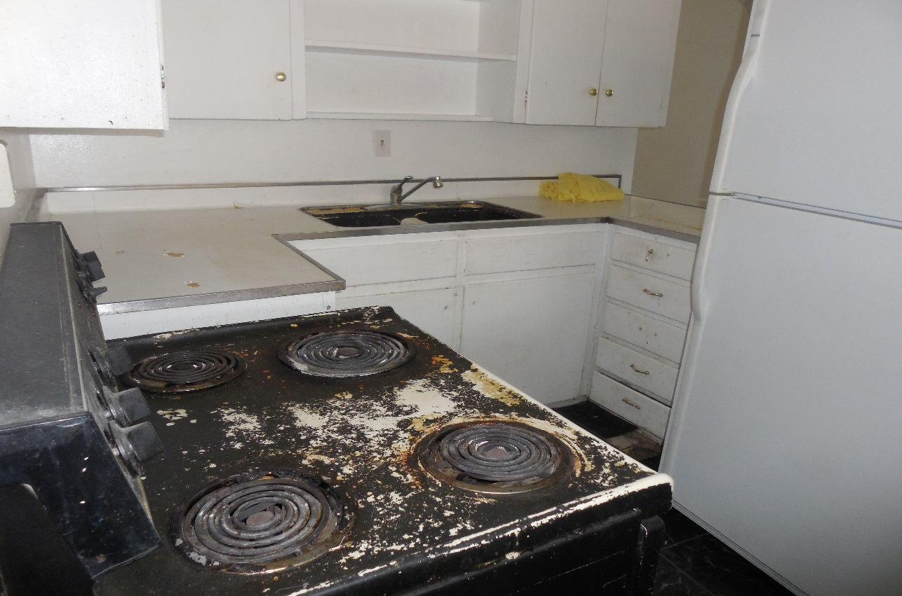
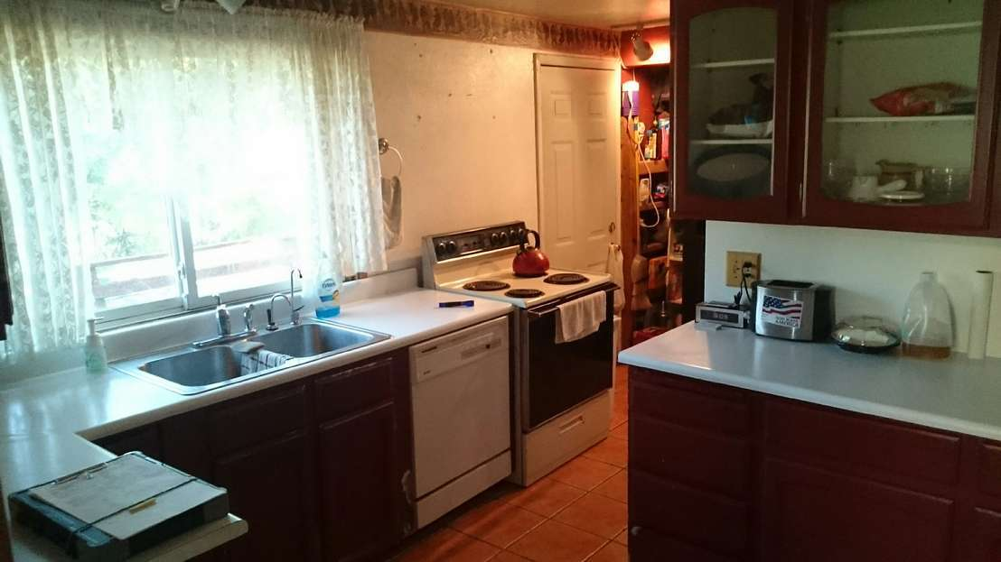
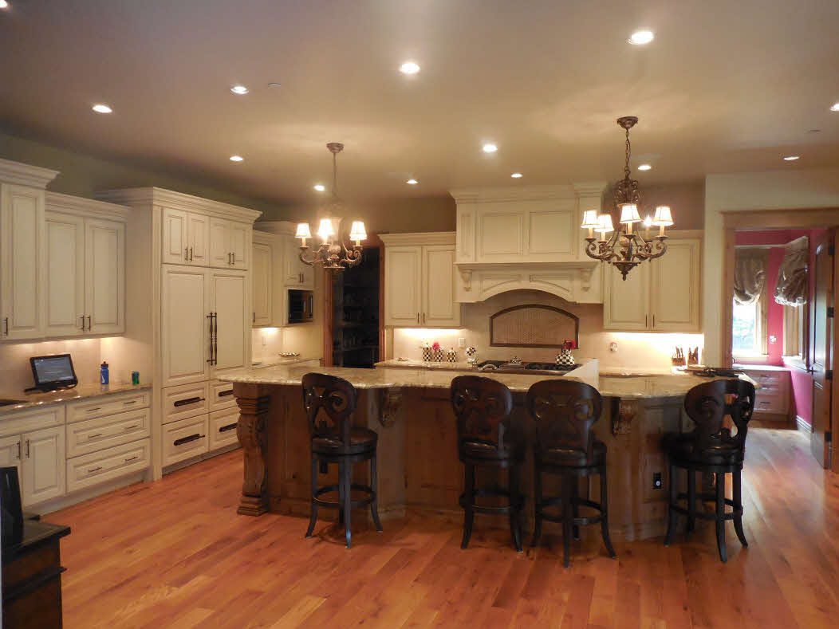
Notes:
Old updated kitchen with significant wear and tear
Somewhat updated kitchen newer appliances countertops refinished cabinetry and flooring,
Million-dollar kitchen and a $4 million Cherry Hills Village house with all William owes cabinets, rope granite countertops high and appliance package. We as appraisers have to use our judgment as to what is the appropriate value associated with either a fully depreciated kitchen, updated kitchen or an over-the-top kitchen
This become somewhat of a sliding scale because updates have a shelf life and it is up to the appraiser to determine at what point are these updates in the lifecycle of that component.

Slide 13
Assessing the degree of depreciation Continued
Exterior
Paint/staining- peeling, UV damage, fading, rotting/deteriorating wood, cracked or delaminated siding
Stucco – cracking, delamination, improper installation resulting in water damage on the edges
Roof –Shakes (curling, missing), Composition (Rolled, 3 tab, T locks, Dimensional), metal, tile, slate
Windows and Doors – single/double/triple pane, vinyl vs wood vs composite, cracked, fogged
Fencing, Decking, Flatwork, landscaping
Notes:
Looking at the exterior the property may be an easier task than trying to determine the lifecycle and depreciation rate for the interior components. Exterior finish is easily accessible to view and there is a great deal of data available on the cost to cure things like paint, roofs, windows, concrete. Additionally the lifecycle of these factors is also fairly widely known.

Slide 14
Notes:
This was one of my favorite all-time houses to appraise first picture is a 9 foot crack through the slab floor that varied in with from ¼ inch up to approximately 1 ½ inches also the living room floor broke left and right with a significant slope each way. Dirt was visible through the crack and daylight visible where the crack about it the exterior walls. Second picture were as a result of animal damage and the homeowner trying to repair that damage with their minimal carpentry skills. As you can see they didn’t own a paintbrush also or a caulk gun.

Slide 15
Notes:
This is the same house and as you can see the entire roof has moved approximately 2 ½ inches back to the east and in doing so it has pulled the soldiering brick along with this movement was due in part to that inch and a half 9 foot crack that ran through the living room floor. The next photo shows where the owner tried to talk point all of the brick joints on the rear of the house that had significant and substantial movement. But as you will see in the second photo the homeowner had no shortage of satellite TV.

Slide 16
Narrowing the Adjusted Sales Price at the bottom the sales comparison grid by changing the adjustment values
Is this paired sales analysis?
How accurate is this method in determining market value and current market trends?
Is this type of adjustment based on market data?
Can the Adjusted Sales Price range be adjusted up to the top of the range, or down to the bottom of the range by an appraiser using their judgment when evaluating the relevant factors?
Is this range directly impacted by comparable selection?
Are these adjustments based on judgement or other factors?
How would these types of adjustment be justified, are they accurate and appropriate?
Notes:
Open Class discussion with Lou facilitating and I will direct the discussion, maybe Jennifer can record responses.
I don’t expect consensus from todays discussion but I hope that you will get an understanding of what your peers are thinking regarding this topic.
One of the comments that we hear as appraisers from our peers is that all we need to do is balance out the adjustments in the sales comparison grid so that we have a narrow range at he bottom and then our opinion of market value is some where in the middle of that range.
Is comparable selection based on the appraisers judgment?
Our definition of science requires that the data and inputs be testable and reproducible, Therefore is this methodology the least scientific or uses no science in development of the adjustment numbers/values? Does market trend analysis follow this same logical path?

Slide 17
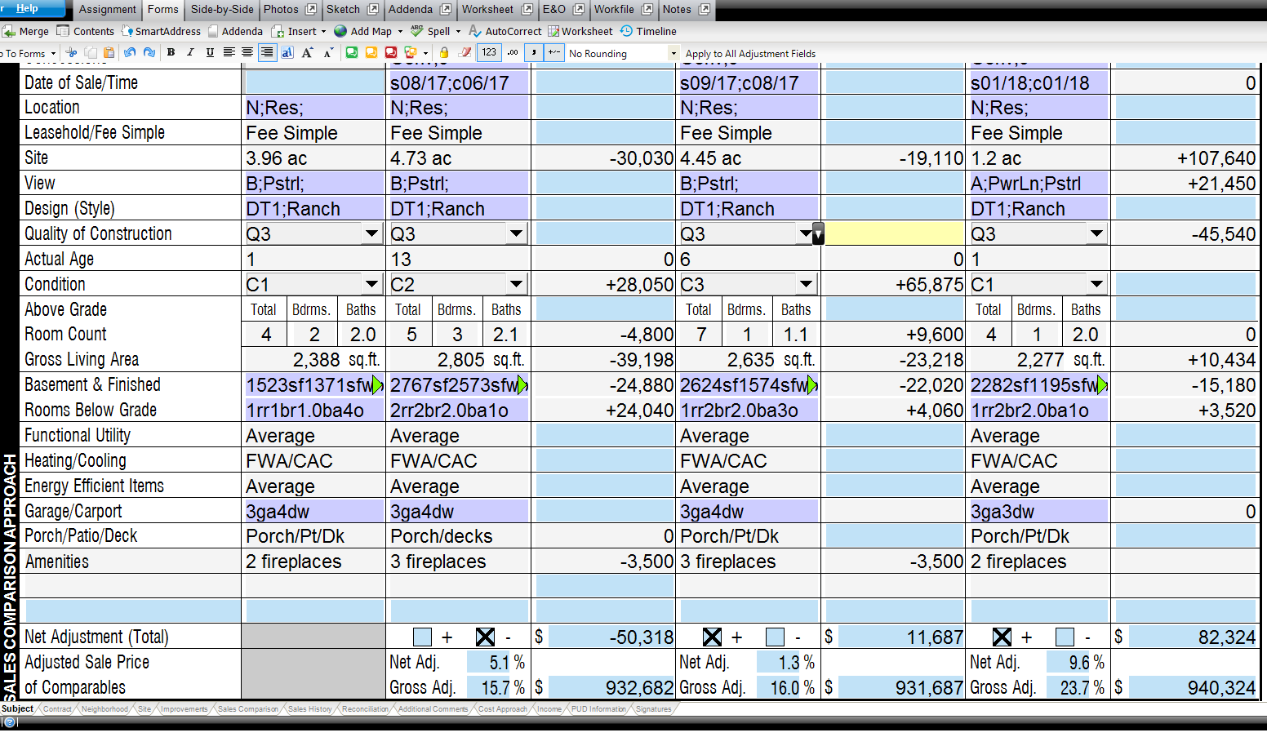

Slide 18
Using Judgment in determining Comparable adjustment values
Land sales show the PPA at $66,544
Market Data for similar and competing properties show the PPA at approximately $39,000
Market data for comparables #1 and #2 show a condition adjustment of approximately $10 psf for Comp #1 and $25 per square foot for Comp #2.
Market data for the GLA adjustment at $94 psf vs the Cost approach showing the GLA at $192 psf.
Notes:
I making adjustments based on market data arbitrary and can it be appropriately justified in the report.

Slide 19
VIEWS
Poor or Adverse Views
Traffic, Highway, Industrial, Commercial, Alley
Average view
Interior residential
Good view
Mountains, Lakes, Rocks, City Skyline, open space
Excellent view
Peak to Peak Mountain views, Expansive City Skyline views, Wilderness or Big Valley forest views
The MILLION DOLLAR VIEW $,$$$,$$$
How does Judgment play a part in determining the difference in views?
Is there a standard for assessing and valuing the view?
Does bias play a role in how you assess and value the view?
Notes:
Everybody I have ever done an appraisal for in the Denver Metro area has a Mountain View, how many people have run up against this amazing phenomenon?
So these are just a few of the ways that I look at and try to evaluate the quality of a view. All of you have experienced most of these views and have determined how to address their value in the report. Has anybody seen a “million-dollar view”. The only one I have ever done was Dan Fogelberg’s house up in wonder view where he could see the whole backside of Rocky Mount national Park and all the way south to Pike’s Peak. That was truly the best view I have ever seen in the Denver Metro area, the problem was it came with 100 mile an hour winds.

Slide 20
Appraisers use their Judgment when comparing the attributes of different views
Mountain view
Rock outcropping View
Notes:
Photo number one is a mountain/tree Valley view, the house photo number two has an incredible rock outcropping view directly off the rear of the house. Even though these views are dissimilar do they have the same contributory value when placed in the report?

Slide 21
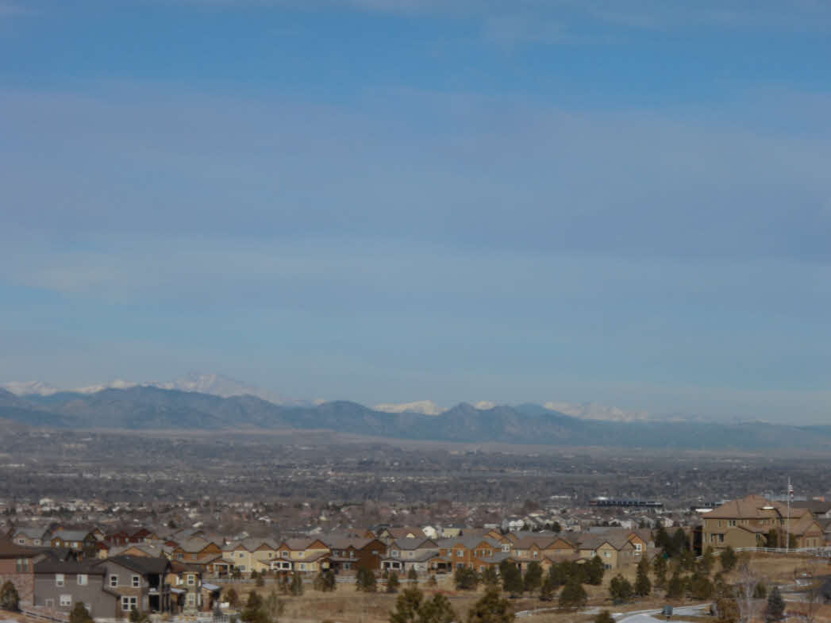
Views - Continued
Mountain View
Mountain view
Notes:
Expansive Mountain view versus a Peek a boo mountain view
Photo number one was taken from a third-floor master suite on a property in backcountry at the very top of the ridge line. This view stretched from Pike’s Peak to Longs Peak and around to include a city skyline view of downtown Denver and the Denver Tech Center.
The second photo was a recent appraisal that I completed where the homeowner told us about this great Mountain View that they, from their living.

Slide 22
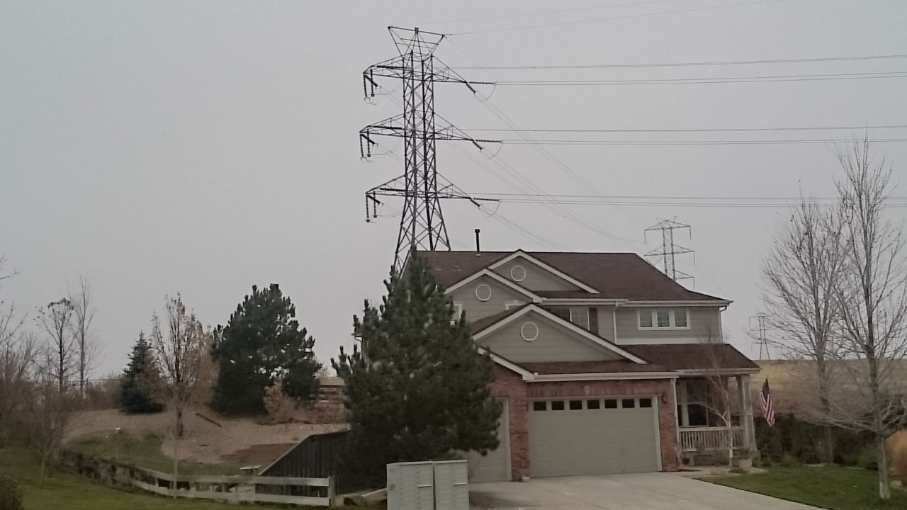
USING GOOD JUDGMENT IN YOUR REPORTS
MLS REALTOR PHOTO
APPRAISER’S PHOTO

Slide 23
What is the correct justification and documentation required to support an appraisers use of judgment when drawing a conclusion stated in a report.
“Because I say so”
My years of experience are the basis for my assertions….
Years of complied data support my conclusions….
My mentor gave me a sheet with all the adjustments so now I have his/hers years of experience combined with mine.
I have collected data over the past year or relevant time frame and reviewed that data as it is applicable to this report and in my judgment applied the appropriate market data derived analysis in my conclusions stated in the report.
Notes:
It is important and it is a requirement of USPAP that appraisers support, document and justify all of the conclusions stated in the report. This has been a difficult and sometimes misunderstood requirement for appraisers when completing a report. I find it very important that when you are drawing your conclusions and subsequently stating the justification for those conclusions in your report that you take time and fully consider all of the relevant factors and observations that you made throughout the process and try to articulate your rationale for how you arrived at those conclusions. If judgment was involved then it is important to state that the appraiser used judgment in determining the relevant conclusions stated in the report.

Slide 24
Justification
The appraiser evaluated the market data for similar and competing properties and determined that due to the availability of properties at this price point, the high demand for properties in this rapidly appreciating market, and current market trends and has concluded that the comparable search area was expanded to include other residential areas with similar and relevant characteristics available to the typical buyer at this price point. The appraiser used judgment in making this determination which was based on drawing conclusions from the relevant and available factors.
Notes:
Sometimes my justifications appear to get wordy thought that’s not as much of a consideration of mine as it is to clearly articulate the reasoning and process behind how each conclusion was reached and stated in the report.

Slide 26
Discussion, Questions, Comments or Concerns

