Slide 2
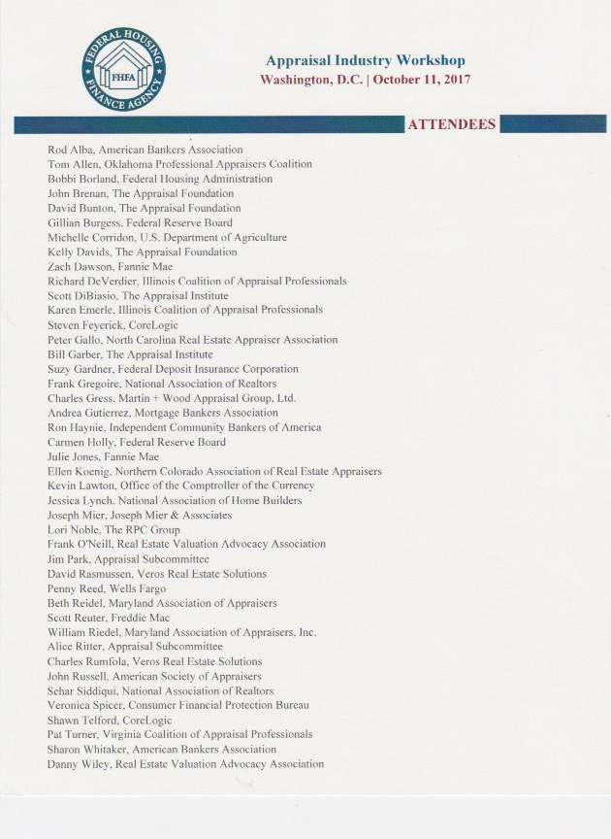

Slide 3
FHFA APPRAISAL INDUSTRY WORKSHOP Washington DC, 10-11-2017
Discussion Points
Under the umbrella of industry challenges, specific issues identified and discussed by industry participants included:
Licensing requirements and appraiser shortages;
Low appraisal fees and short turn-times contribute to shortages in rural markets;
The need for alternative paths to licensure to the college degree requirements;
A source of meaningful training for new appraisers;
Adding provisions in licensing requirements that would allow trainees to gain practical experience; and,
Use of technology to help trainees gain practical experience.
In discussing modernization of the appraisal process and developing possible solutions to current challenges, industry participants shared the following views:
The need for updated appraisal forms and/or data structures;
Use of technology to train appraisers;
Market relevant data, available to the Enterprises, could be provided to appraisers; and,
Solutions to the appraisal problem that address the gap between the use of automated valuation models and a full appraisal.

Slide 4
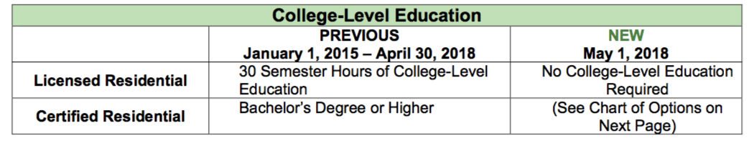
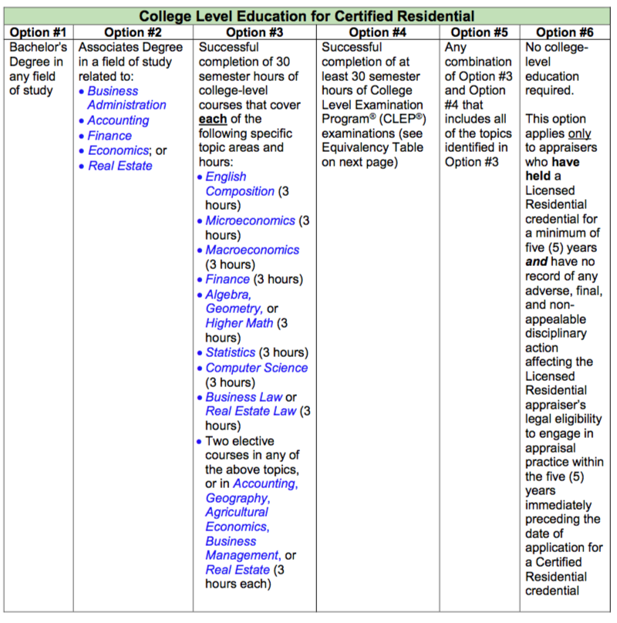
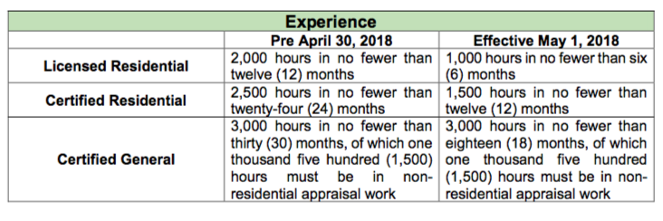

Slide 5
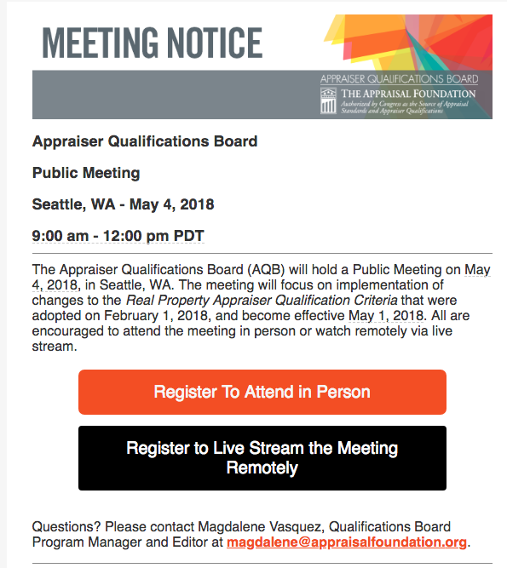
For more details and information regarding qualification criteria:
www.TheAppraisalFoundation.org under Standards and Qualifications tab
and
www.NCAREA.org under Resource tab

Slide 6
Highlights 2017 AARO Fall Conference
October 13-16, Washington DC
Updates from the Feds
The Appraisal Foundation (TAF) ~David Bunton
Appraisal Subcommittee (ASC) ~Jim Park
Consumer Finance Protection Bureau (CFPB) ~Veronica Spicer
Role of Review Appraisers
The Role of Appraisal Review in a Regulator’s Mission
~Amy McClellan and Stephen Wagner
Trainee Regulatory Programs
New Concepts and Best Practices in an Evolving Industry
~Debi Jones, Greg Stephens and Craig Morley
Appraiser Independence
Appraiser Independence and AMCs - Is it true Independence?
~Frank Gregoire and Alan Hummel
You can review these presentations by going to https://www.aaro.net/conference_presentations.php

Slide 7
TRAINEE REGULATORY PROGRAMS
Online or Cloud Based Experience Log
Accessible to Trainee, Mentor and Regulator
Proactive Not Reactive
Easier For All Parties to Monitor Progress
Requires Periodic Entries
Prevents Attempts at Recreating Years Worth of Experience
Little to No Cost
Reduces Paperwork
Mid‐Term Reviews
Opportunity for Learning and Feedback
Helps Identify Problems Earlier in the Process
Saves Time During the Final Review
Able to Issue Licenses More Quickly

Slide 8
Home Measurements: Should it be regulated?
ANSI Standards for Measuring
ANSI needs to be mandated for anyone who measures square footage for the public.
Organizations such as NAR should mandate brokers enter square footage into the MLS correctly.
Teach “how to” and “why” it matters.
Need to understand every step and recognize mistakes.
Qualified vs Competent

