Slide 1
VA Back to Basics
Presented by: Andrew Lofland, SRA – VA Lead Appraiser
Prepared by : Loan Guaranty Service
April 2018

Slide 2
C&V’s Responsibilities and Vision
C&V’s Responsibilities:
The Construction and Valuation (C&V) Section is responsible for the quality of appraisal reports on properties offered as security for VA guaranteed loans.
C&V’s Vision:
Credibility and Quality
Standardization
Risk Management
Performance

Slide 3
Resources
Lender’s Handbook VA Pamphlet 26-7, Revised
VA Web Automated Reference Material System
Uniform Appraisal Dataset Specification (UAD)
VBA Circulars
Appraiser Application – VA Appraiser Fees

Slide 4
Colorado
Clear Creek & Kit Carson (NONE) Park & Hinsdale (1 appraiser on Panel) Chafee (2 appraisers on Panel) Costilla (2 appraisers on Panel) Jackson (1 appraiser on Panel)
Kiowa (NONE) Lake (1 appraiser on Panel) Delta & Eagle (2 appraisers on Panel) Custer (2 appraisers on Panel) Fremont & Grand (2 appraisers on Panel) Huerfano (1 appraiser on Panel) Las Animas (1 appraiser on Panel) Saguache (1 appraiser on Panel) Alamosa (2 appraisers on Panel) Crowley Conejos (2 appraisers on Panel) Rio Grande (2 appraisers on Panel) Routt (2 appraisers on Panel) Garfield (2 appraisers on Panel) Mineral (NONE) Montezuma, Rio Blanco & Summit (1 appraiser on Panel) Yuma (1 appraiser on Panel) Washington (1 appraiser on Panel) Baca (1 appraiser on Panel) Bent (1 appraiser on Panel) Delores (1 appraiser on Panel) La Plata & Lincoln (1 appraiser on Panel) Ouray
San Miguel (2 appraisers on Panel) San Juan (1 appraiser on Panel) Prowers (1 appraiser on Panel) Pitkin (1 appraiser on Panel) Phillips (1 appraiser on Panel)

Slide 5
Wyoming
Albany (1 appraiser on Panel) Carbon (2 appraisers on Panel) Converse (2 appraisers on Panel) Crook (1 appraiser on Panel) Fremont (1 appraiser on Panel) Hot Springs (1 appraiser on Panel) Johnson (2 appraisers on Panel) Niobrara (1 appraiser on Panel) Platte (1 appraiser on Panel) Sublette (1 appraiser on Panel) Sweetwater (2 appraisers on Panel) Teton (2 appraisers on Panel) Uinta Weston (1 appraiser on Panel)

Slide 6
Case Transfers
LAPP to LAPP (Chapter 13)
Procedures for Change Lender Link in WebLGY
Who Transfers Cases?
Who Does Not Transfer Cases?
Reasons Why VA Should Not Transfer Cases
When Would VA Transfer a Case and How

Slide 7
Reassigning Appraiser
Validate Reassignment Request
Document Reason for Reassignment with Detailed Notes
Clarify Any Conflict of Interest
Look at Notes (has it already been reassigned)?

Slide 8
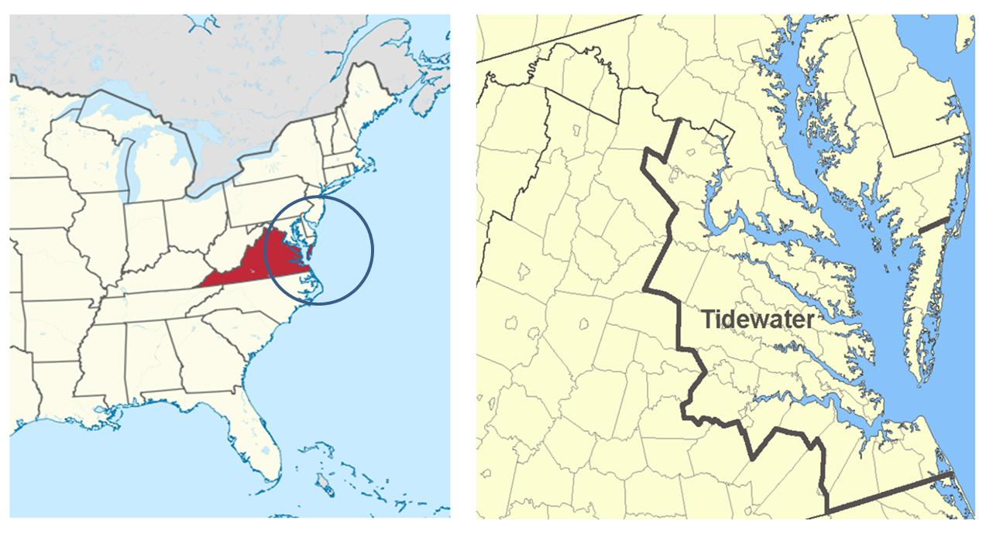
Tidewater History
In 2003, the Tidewater process began as a test program in what is commonly known as the “Tidewater” region of southeastern Virginia
Gives lender or designee the opportunity to provide additional information prior to completion of the appraisal
Notes:
Presenter 1: The Tidewater process has been in existence since 2003. It gets its name from where it began as a test case in the “Tidewater” region of Virginia (Norfolk, Virginia Beach, Hampton, and Portsmouth Virginia). While the appraiser is not communicating a finding of value, the process does provide the lender or designee the opportunity to provide additional information prior to completion of the appraisal report. One of the goals of the Tidewater process is to reduce the amount of reconsiderations of value by giving lenders and interested parties an opportunity to provide relevant information prior to completion of the report.

Slide 9
Tidewater
What cases can have Tidewater?
Proper Notification
Timeliness (48 business hours) Maximum
Appraisal needs to be 100% complete
NOV must be issued
Notify Lender POC on 26-1805 Only (Reference Circular 26-17-18)

Slide 10
Tidewater
Tidewater Circulars
Established in 2003 by VA Circular 26-03-11
Currently updated by Circular 26-17-18
Only applies to purchase transactions
Purpose is to provide relevant market data to VA fee appraisers resulting in fewer value disputes
Notes:
There are two VA Circulars that outline the Tidewater process, 26-03-11 and 26-17-18. Tidewater only applies to purchase transactions. While housing data sources have improved, there are still times when relevant sales are not readily available via traditional data sources. Using the Tidewater process gives lender or designee the opportunity to provide additional sales data that may support the contract price.

Slide 11
Tidewater
Tidewater Process
Appraiser contacts the listed point of contact (POC) on VA Form 26-1805 when the appraised value of a property is likely to be lower than the sale price.
The appraiser will -
Contact listed POC
Add public note in WebLGY when Tidewater is enacted
Only discuss enacting Tidewater with POC
Not to discuss the content of the appraisal
Notes:
Appraiser notifies the listed POC on the 26-1805, Request for Determination of Reasonable Value, when it appears that the appraised value will be lower than the sales price of the subject property. This is important for lenders to designate the proper POC and make sure the POC is aware of Tidewater and proper process. The lender may designate whomever they feel is most appropriate as the POC including realtor, loan officer/originator, or any other party. Additionally, the appraiser must enter public notes in WebLGY as documentation that this process has been initiated.
At this point, the appraiser is not at liberty to discuss the content of the appraisal with the POC beyond explaining that they are enacting tidewater and that the POC may provide additional information in support of the transaction. VA expects full cooperation between the fee appraiser and the specified POC.

Slide 12
Tidewater
Tidewater Process
POC has two business days to respond from the date of first contact
Preferred format is similar to the comparable sales grid or Multiple Listing Service (MLS) property reports
Must be closed sales, not listings
Notes:
Once the fee appraiser has notified the POC, they will have two working days to provide additional information to the fee appraiser. MLS property reports are highly recommended. Verification that the sale actually closed is also a requirement.
If pending sales contracts are submitted to support a time adjustment, they must be completed with all contract addendums attached. In addition, a brief narrative describing the similarities/differences between the pending sale and the subject property should be included.
Appraiser reviews the information, completes the report and uploads to WebLGY.

Slide 13
Tidewater
Tidewater Best Practices
Communication
Provide information as quickly as possible and document WebLGY notes.
Documentation
Provide information and data in a clear and concise manner.
Refer to VA Circular 26-17-18 or contact the RLC with any questions

Slide 14
Washington State Law
Liquidation Access Rules
Three Attempt to Gain Access/Deed-in-Lieu
Exterior Only are Authorized for Vacant Properties
Lender Can Access to Protect the Property
This Photo by Unknown Author is licensed under CC BY-SA

Slide 15
Appraiser Leave Requests
Any Request Over a Month (Lead or Supervisor)
Over Three Months (Supervisor Only)
Check Appraisers Pending Assignments
Is this for Workload
Leave Request Must be in Writing (Prefer Leave Request Form)
Leave Request Are Uploaded in SIM

Slide 16
NOV Repair Requirements
Verify that Repairs are VA MPRs (Safe, Sound & Sanitary)
Does SAR Understand the Appraisers Call for MPRs
Are they Really a VA MPR?
Cosmetic VS MPR
Look at Notes and Prior Appraisal Uploads (Has the MPR Changed)?
Is Lender Pressuring Appraiser to Change to “AS IS”

Slide 17
Other NOV Issues
Pest Inspection
Water and Septic Inspections (Alaska and Idaho Local Requirements)
Private Roads (Easements and Road Maintenance)
Oregon Statute for Private Roads
Flood Insurance (NOV State Improvements)
Warranty Requirements (12a/19 and 12b/13
Item 20 Inclusions e.g. Shared Well, Community Well, Certificate of Occupancy, etc..

Slide 18
Native American Direct Loan (NADL)
When is it NADL or Fee Simple?
Who Funds NADL
Who Qualifies for NADL
William Haines of Loan Production (NADL Coordinator)
Andrew Lofland (NADL Appraisal Lead)
https://www.vets.gov/housing-assistance/home-loans/loan-options/nadl/

Slide 19
Questions

