Slide 1
7-Hour National USPAP Update Course
Ethics, Standards, and Your Appraisal Practice

Slide 2
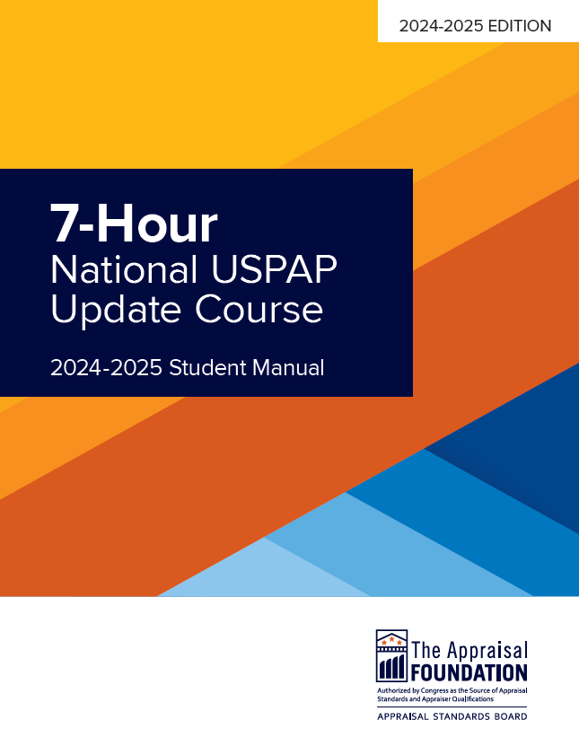
Welcome!

Slide 3
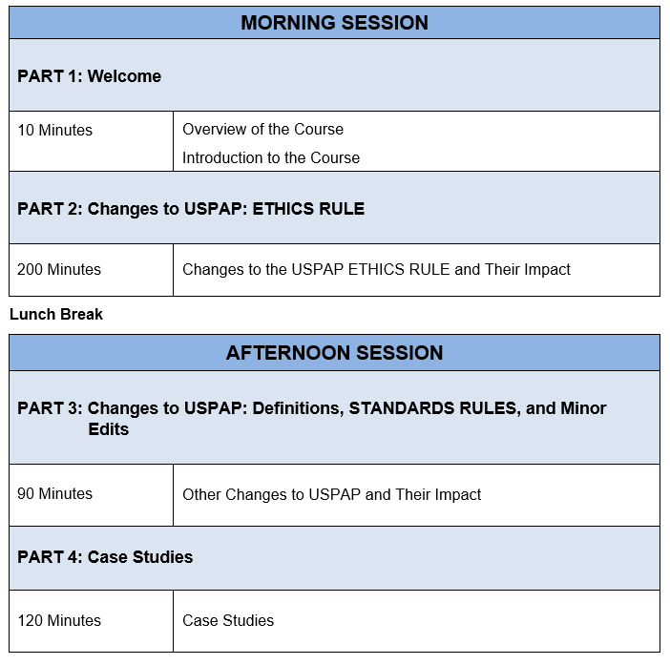
Course Schedule
Notes:
Remember – this PowerPoint slide show is an instructional aid; it is not the course!

Slide 4
Course Design
Course explores changes to USPAP, including
Changes to the ETHICS RULE
Change to Definitions, Standards Rules, and Minor Edits
Includes Illustrations, Exercise Questions, and Case Studies
Notes:
Remember – this PowerPoint slide show is an instructional aid; it is not the course!

Slide 5
Course Objectives
Page 2
Present and explain the revisions to USPAP that were adopted in 2023 and are effective starting January 1, 2024.
Present the current changes to USPAP in a variety of scenarios for class discussion.
Present scenarios that challenge participants to apply USPAP to situations they encounter in their daily practice.

Slide 6
Required Course Materials
Page 2
2024-2025 7-Hour Update Course Student Manual
2024 Uniform Standards of Professional Appraisal Practice (USPAP)
Now a stand-alone publication
2024 Guidance and Reference Manual (GRM)
Contains AOs, FAQs, and the Reference Index

Slide 7
Classroom/Attendance Guidelines
Page 3
In Person
No smoking
Silence electronic devices
All
Audio/video recording is prohibited
Be considerate
Zoom
Enter your full legal name on Zoom – Identical to your license
Must remain on camera to receive credit
Please mute yourself unless you are asking a question
Use the chat box or raise your hand to communicate with the instructor or attendance monitors

Slide 8
General Information
Page 3
Break times and lunch
Attendance sheets
Course certificates

Slide 9
INTRODUCTIONS – Instructor
JoAnn Apostol
Deer Creek Appraisals
DeerCreekAppraisals@msn.com
Certified Residential Appraiser
AQB Certified USPAP Instructor
RMAA Board Member
Notes:
Fill in your information on this page

Slide 10
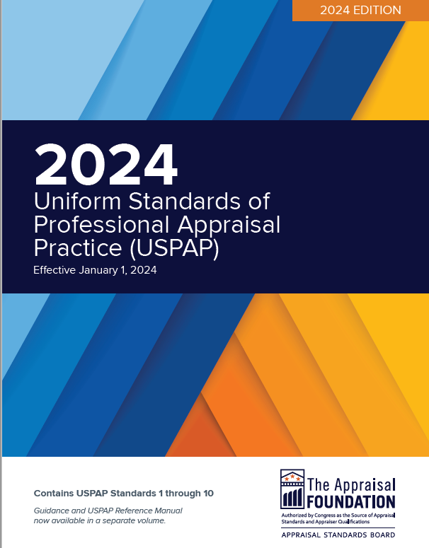
The Importance of Public Trust

Slide 11
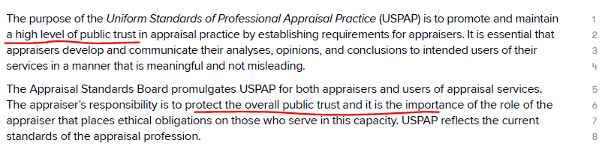
Before we begin…
–
–
Page 5
Where in USPAP is the term “public trust” used?
Preamble
ETHICS RULE

Slide 12
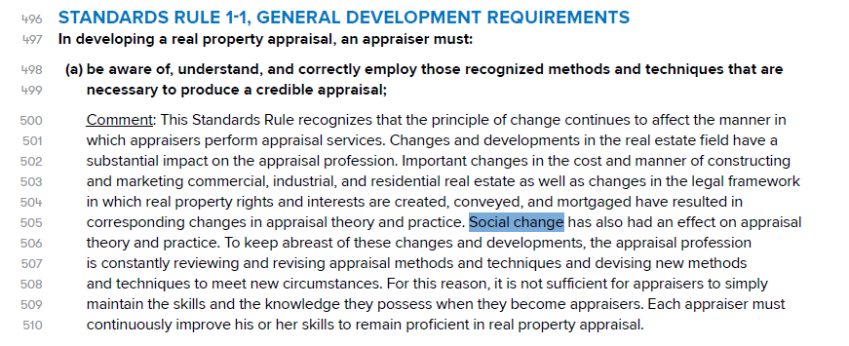
Before we begin…
–
–
Page 5
Which Standards Rule mentions the concept of social change?
Rules 1-1 & 7-1
What impact does social change have on the industry and appraisers?

Slide 13
Changes to USPAP— ETHICS RULE
Part 2:

Slide 14
Summary of Changes
Page 7
This part of the course covers:
Changes to the ETHICS RULE
Nondiscrimination Section
Review of the Rule

Slide 15
Changes to ETHICS RULE
Page 8
Nondiscrimination section added to ETHICS RULE
Rationale for Changes
Appraisal discrimination is a serious problem
Appropriateness and accuracy of the ETHICS RULE prohibition concerning “unsupported conclusions” was questioned

Slide 16
Changes to ETHICS RULE
Page 8
Nondiscrimination section added to ETHICS RULE
Rationale for Changes (continued)
ASB concluded that this prohibition be replaced with more clear, direct, and detailed prohibitions
Appraisers and users of appraisal services can easily understand how USPAP prohibits violations of antidiscrimination laws

Slide 17
Changes to ETHICS RULE
Page 8
Nondiscrimination section added to ETHICS RULE
Rationale for Changes (continued)
Nondiscrimination section specifically states it is a prohibition of USPAP to violate:
the Fair Housing Act (FHAct)
the Equal Credit Opportunity Act (ECOA)
the Civil Rights Act of 1866
any other applicable state or local antidiscrimination law

Slide 18
Changes to ETHICS RULE
Pages 8-9
Nondiscrimination section added to ETHICS RULE
Key Elements and Concepts
Establishes requirements for appraisers regarding their nondiscrimination obligations
Specifically addresses compliance with antidiscrimination laws and regulations

Slide 19
Changes to ETHICS RULE
Pages 8-9
Nondiscrimination section added to ETHICS RULE
Key Elements and Concepts (continued)
Reflects core concepts of key antidiscrimination laws
Advisory Opinions 39 and 40 provide guidance
Use AO 39 and 40 as resource in this course

Slide 20
Changes to ETHICS RULE
Page 9
Guidance on new Nondiscrimination section
Advisory Opinion 39
Discusses the ETHICS RULE and the COMPETENCY RULE
FHAct, ECOA, and the Civil Rights Act of 1866
How these laws are relevant to appraisal practice
Disparate treatment and disparate impact
In limited circumstances reliance on protected characteristics is permitted under the Nondiscrimination section

Slide 21
Changes to ETHICS RULE
Page 9
Guidance on new Nondiscrimination section
Advisory Opinion 40
Specific to residential real property appraisal
Requirements of antidiscrimination laws and USPAP
More on FHAct and other relevant laws and regulations
Guidance on research, analysis, and reporting of location-related data for residential real property assignments
Pretext and “code words” that can suggest that discrimination has occurred

Slide 22
Nondiscrimination Section
Page 10
Introduction
Determining whether an individual has engaged in discrimination is not always a simple task.
Stay alert to the types of actions that raise questions about compliance with USPAP nondiscrimination requirements and antidiscrimination law.

Slide 23
Nondiscrimination Section
Page 10
Introduction
Sample questions that could be raised:
“Did the appraiser base this opinion of value in whole or in part on a protected characteristic?”
“Did the appraiser use or rely upon a protected characteristic?”
“Did the appraiser make decisions during this assignment because of a protected characteristic?”
“Was this appraiser’s conduct impermissibly influenced by a protected characteristic?”

Slide 24
Nondiscrimination Section
Page 10
Background
Identifiers for reviewing Nondiscrimination section for this course
All content falls into one of four categories:
A prohibition
A requirement
An exception to a requirement or to a prohibition
A Comment which does not contain a prohibition, a requirement, or an exception, but rather provides information.

Slide 25
Nondiscrimination Section
Pages 12-17
Paragraph by paragraph breakdown - Overview
Section One: Requirements and Prohibitions Related to Antidiscrimination Laws
Paragraphs 1 - 10
Section Two: Additional Antidiscrimination Requirements
Paragraphs 11 - 17
Section Three: Exceptions
Paragraphs 18 - 19

Slide 26
Nondiscrimination Section
Pages 15-16
Section One: Requirements and Prohibitions Related to Antidiscrimination Laws
Paragraphs 1 – 10
Ensures appraiser who complied with USPAP also complied with applicable antidiscrimination laws and regulations
Paragraphs 3, 4, & 5 apply only to residential real property assignments
Paragraphs 7 & 8 apply when intended use of assignment results is in connection with a credit transaction

Slide 27
Nondiscrimination Section
Page 16
Section Two: Additional Antidiscrimination Requirements
Paragraphs 11 – 17
Apply whether or not any antidiscrimination law or regulation applies
Appraisers must not engage in discrimination based on race, ethnicity, gender, or sexual orientation, regardless of, and independent of, legal liability

Slide 28
Nondiscrimination Section
Page 16
Section Two: Additional Antidiscrimination Requirements (continued)
Paragraphs 11 – 17
USPAP extends requirements beyond the scope of any particular law or regulation
Even when antidiscrimination laws do apply in an assignment, these requirements often cover the same types of conduct covered in paragraphs 1-10

Slide 29
Nondiscrimination Section
Page 17
Section Three: Exceptions
Paragraphs 18 – 19
In certain limited circumstances, use of or reliance upon protected characteristics in an assignment otherwise prohibited should nevertheless be allowed
Limited circumstances when such use or reliance is ethical and permitted

Slide 30
Nondiscrimination Section
Page 17
Section Three: Exceptions (continued)
Paragraphs 18 – 19
See guidance in AO-39. NOTE: exceptions exist only where such use or reliance is not prohibited by law or regulation
In Nondiscrimination section, exceptions listed separately from the prohibitions and requirements

Slide 31
Review of the Rule
Page 18
Illustrations and Questions
Many of the exercises in this portion of the course can have more than one correct answer
Focus on understanding how scenarios do or do not raise concerns about discrimination based on the facts provided
Please read and answer the questions in your student manual.

Slide 32
Review of the Rule
Page 18
Section One: Requirements Related to Antidiscrimination Laws
Paragraph 1 – Prohibition
An appraiser must not act in a manner that violates or contributes to a violation
of federal, state, or local antidiscrimination laws or regulations. This includes
the Fair Housing Act (FHAct), the Equal Credit Opportunity Act (ECOA), and the
Civil Rights Act of 1866.
Paragraph 2 - Requirement
An appraiser must have knowledge of antidiscrimination laws and regulations
and when those laws or regulations apply to the appraiser or to the assignment.
An appraiser must complete an assignment in full compliance with applicable
laws and regulations.

Slide 33
Review of the Rule
Page 18
Paragraphs 1 & 2 Example
Appraiser agrees to perform an assignment on a single-family house in Connecticut, how do they determine which laws might apply?
Key Factors:
Residential property – see page 121 GRM
USPAP Sections -
FHAct
Connecticut specific

Slide 34
Review of the Rule
Page 19
Section One: Requirements Related to Antidiscrimination Laws
Paragraph 3 – Prohibition
1. An appraiser, when completing a residential real property assignment,
must not base their opinion of value in whole or in part on race, color,
religion, national origin, sex, disability, or familial status.
Paragraph 4 - Information
Comment: The FHAct prohibits discrimination in residential real estate
appraisals on the basis of race, color, religion, national origin, sex,
disability, or familial status. Under the FHAct, an appraiser may not use or
rely upon information relating to these protected characteristics, with
limited exceptions.

Slide 35
Review of the Rule
Page 19
Paragraph 3 Example
During a site visit, the “race” is determined to be a minority, appraiser selects comparables believed to be owned or in a subdivision of similar people. Is this allowed?
Key Factors:
Considered Race
Same if the owner hadn’t been there and surmised based on the contents of the house

Slide 36
Review of the Rule
Page 19
Paragraph 4 Example
Does demographic information constitute information relating to a protected characteristic?
Yes
Census data is related to protected characteristics
Using or relying on this information is prohibited.

Slide 37
Review of the Rule
Page 20
Section One: Requirements Related to Antidiscrimination Laws
Paragraph 5 – Information
The FHAct can be violated through disparate treatment (treating
individuals of one protected group differently from and less favorably than
others not in that protected group) and disparate impact (employing
neutral policies or practices that disproportionately harm members of a
protected group, except when those policies or practices are justified and
there are no less disproportionate policies or practices that could be used
instead).

Slide 38
Review of the Rule
Page 20
Paragraph 5 Example
Appraiser spends 30 minutes inspecting tract housing and 1 hour in custom/historic properties. Is this disparate treatment?
No
Disparate treatment is based on individuals, not properties
Can’t use property types to purposely treat a client or owner differently. (Pretext)

Slide 39
Review of the Rule
Page 21
Section One: Requirements Related to Antidiscrimination Laws
Paragraph 6 – Information
Section 1981 of the federal Civil Rights Act of 1866 prohibits many forms
of discrimination with respect to the making and enforcement of contracts,
and Section 1982 of the same law prohibits discrimination with respect to
the purchasing, leasing, selling, holding, and conveyance of real and
personal property. The Civil Rights Act of 1866 applies to real property
appraisals, in addition to personal property and other appraisals.

Slide 40
Review of the Rule
Page 21
Paragraph 6 Example
Appraiser performs assignments for white clients but refuses assignments from potential black clients Is this a USPAP violation?
Yes
Civil Rights Act of 1866
Violates the law, so violates USPAP

Slide 41
Review of the Rule
Page 21
Section One: Requirements Related to Antidiscrimination Laws
Paragraph 7 – Prohibition
2. An appraiser, when completing an assignment where the intended use is in
connection with a credit transaction, not limited to credit secured by real
property, must not base their opinion of value in whole or in part on race,
color, religion, national origin, sex, marital status, age, source of income,
or the good-faith exercise of rights under the Consumer Credit Protection
Act.
Paragraph 8 – Information
Comment: ECOA prohibits discrimination in any aspect of a credit
transaction on the basis of race, color, religion, national origin, sex, marital
status, age, source of income, or the good-faith exercise of any right under
the Consumer Credit Protection Act in any aspect of a credit transaction,
with limited exceptions. An appraisal used in connection with a credit
transaction is an aspect of the credit transaction.

Slide 42
Review of the Rule
Page 22
Paragraph 7-8 Example
Appraiser agrees to do an appraisal of an asset that is intended to be collateral in connection with a business transaction. Does ECOA apply?
Yes
Business loan – could be contributing to ECOA violation
Could violate paragraphs 1 and 7

Slide 43
Review of the Rule
Page 21
Paragraph 7-8 Example Part 2
The assignment is complete. Unknown by the appraiser, the loan is denied due to contested charges. Has the appraiser contributed to a Violation?
No
Creditor may have issues due to the denial
Appraiser complied with USPAP
If the client violates ECOA, it does not come back to the appraiser

Slide 44
Review of the Rule
Page 23
Section One: Requirements Related to Antidiscrimination Laws
Paragraph 9 – Prohibition
3. An appraiser must not violate any state or local antidiscrimination laws or
regulations applicable to the appraiser or to their assignment.
Paragraph 10 – Information
Comment: State and local laws may expand upon federal
antidiscrimination requirements to protect additional characteristics and/or
prohibit additional practices. The specific laws and regulations that are
applicable to an appraiser or an assignment will vary.

Slide 45
Review of the Rule
Page 23
Paragraph 9-10 Example
New York State and NYC have antidiscrimination laws that mirror federal law, but some provisions are more protective
NY State prohibits discrimination based on military status, victim of domestic violence.
NYC prohibits discrimination based on occupation, victim of sex assault or stalking
An appraisal in NYC has both that apply

Slide 46
Review of the Rule
Page 23
Paragraph 9-10 Example
Colorado also has an Anti-discrimination Law called CADA – Colorado Anti-Discrimination Act C.R.S. 24-34-301
Colorado prohibits unfair employment practices based on similar protected classes
Colorado also prohibits unfair housing practices, discrimination in places of public accommodations and discriminatory advertising.

Slide 47
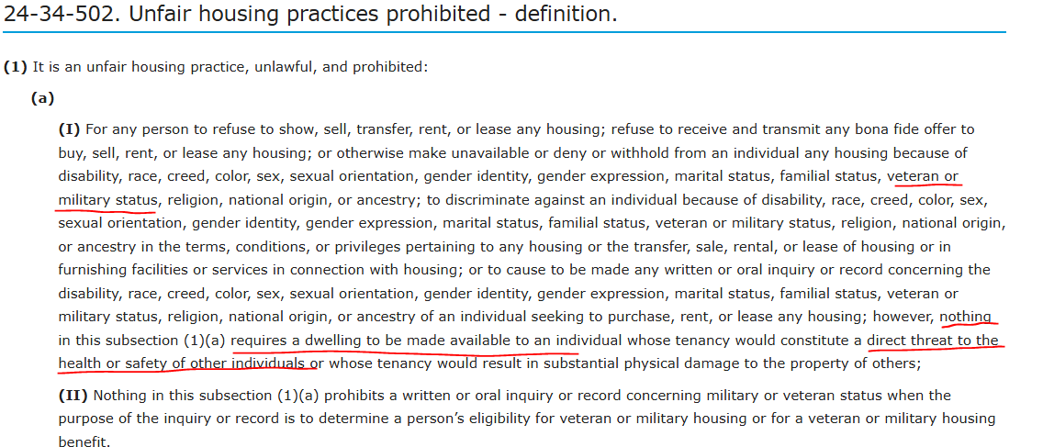
Review of the Rule
Page 23
Colorado Housing

Slide 48
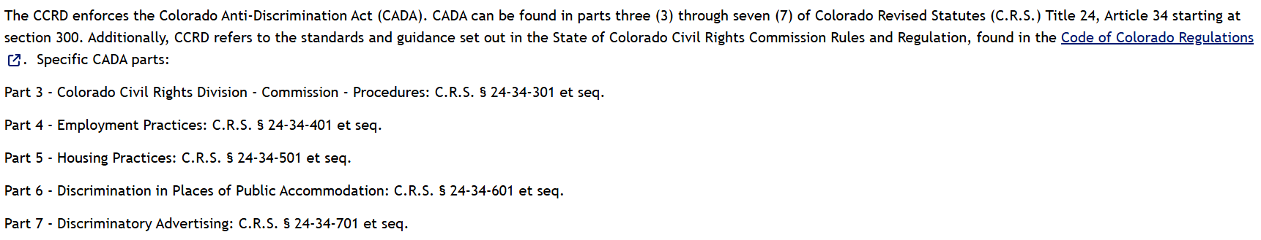
Review of the Rule
Page 23
Colorado Anti-discrimination

Slide 49
Review of the Rule
Page 24
Section Two: Additional Antidiscrimination Requirements
Paragraph 11 – Prohibition /Requirement
Whether or not any antidiscrimination law or regulation applies:
Paragraph 12 – Prohibition
1. An appraiser must not develop and/or report an opinion of value that, in
whole or in part, is based on the actual or perceived race, ethnicity, color,
religion, national origin, sex, sexual orientation, gender, gender identity, gender expression, marital status, familial status, age, receipt of public
assistance income, or disability of any person(s).

Slide 50
Review of the Rule
Page 24
Section Two: Additional Antidiscrimination Requirements
Paragraph 13 – Information
Comment: Within the context of the Nondiscrimination section of the ETHICS
RULE, “person(s)” includes but is not limited to:
a property or asset owner;
a purchaser or potential purchaser of a property or an asset;
an individual who might derive benefit from or use a property or an asset;
a client, representative or agent of a client, or any other intended user; or
the inhabitants of a geographic area.

Slide 51
Review of the Rule
Page 24
Paragraph 13 Example 1
Value opinion of a Mexican Folk Art owned by a Mexican American collector. Is it acceptable to base the value on the owner’s ethnicity?
Based on the facts, no
Even if no law applies, it’s not acceptable under USPAP

Slide 52
Review of the Rule
Page 25
Paragraph 13 Example 2
Value opinion of the first edition of Pride and Prejudice. Most buyers are likely women. Concerns?
Relationship of buyers being women raises concern that possible bias is included
Is it relevant that buyers are women?
Only rely on protected characteristics if is essential to the assignment.
Acceptable to note the author was a woman and historically significant.

Slide 53
Review of the Rule
Page 25
Section Two: Additional Antidiscrimination Requirements
Paragraph 14 – Prohibition
2. An appraiser must not base an opinion of value upon the premise that
homogeneity of the inhabitants of a geographic area is relevant for the
appraisal.
Paragraph 15 – Prohibition
3. An appraiser must not perform an assignment with bias with respect to the
actual or perceived race, ethnicity, color, religion, national origin, sex,
sexual orientation, gender, gender identity, gender expression, marital
status, familial status, age, receipt of public assistance income, or
disability of any person(s).

Slide 54
Review of the Rule
Page 25
Paragraph 14 Example
American Institute of Real Estate Appraisers and others, agreed that improper to base value on the homogeneity of the inhabitants of an area to maximize value
If the value opinion is based on the subject being in a neighborhood where all people are on religion, it’s a violation.

Slide 55
Review of the Rule
Page 26
Paragraph 15 Example
Site visit reveals the owner is LGBTQ+. Appraiser discusses they are against gay marriage. Issues?
The discussion indicates a bias
No matter what that appraiser does, raises concern about possible discrimination and USPAP violations
Remember it’s about perception!

Slide 56
Review of the Rule
Page 27
Section Two: Additional Antidiscrimination Requirements
Paragraph 16 – Prohibition
4. An appraiser must not use or rely upon another characteristic as a pretext
to conceal the use of or reliance upon race, ethnicity, color, religion,
national origin, sex, sexual orientation, gender, gender identity, gender
expression, marital status, familial status, age, receipt of public assistance
income, or disability of any person(s), when performing an assignment.

Slide 57
Review of the Rule
Page 27
Paragraph 16 Example
Tract A and B are regular areas. A is 85% Native American and B is 90% Asian. Two reports same day but Tract A has significant crime statistics and “high Crime Area” Violation?
Including crime in one report and not the other suggests crime is used as a pretext.
High crime area = code word = race is included in the valuation
Remember it’s about perception!

Slide 58
Review of the Rule
Page 28
Section Two: Additional Antidiscrimination Requirements
Paragraph 17 – Information
Comment: Where an antidiscrimination law or regulation applies to the appraiser
or the appraiser’s assignment, the practices described in 1-4 immediately above
may also be prohibited by applicable antidiscrimination law, including the FHAct,
ECOA, and the Civil Rights Act of 1866. Any practice prohibited by an applicable
antidiscrimination law or regulation is also prohibited by the preceding
requirements of the Nondiscrimination section.

Slide 59
Review of the Rule
Page 28
Paragraph 17 Example
Mortgage transaction of a duplex – appraiser bases opinion on the race of the owner. What laws or regulations have been violated?
FHAct and ECOA
Sections 1981 & 1982 of the Civil Rights Act
Possible state law
USPAP references – 1-17!!!!!!!!!

Slide 60
Review of the Rule
Page 29
Section Three: Exceptions
Paragraph 18 – Exception
If an assignment does not involve residential real property and the intended use
is not in connection with a credit transaction, the FHAct and ECOA do not apply.
If the FHAct and ECOA do not apply, and no other law or regulation prohibits the
use of or reliance upon a protected characteristic, then the use of or reliance
upon that characteristic is permitted only to the extent that it is essential to the
assignment and necessary for credible assignment results.
Paragraph 19 – Information
Comment: Where the FHAct, ECOA, or another antidiscrimination law or
regulation applies, any use of or reliance upon a protected characteristic must be
expressly permitted by applicable laws or regulations.

Slide 61
Review of the Rule
Page 29
Paragraph 18-19 Example
Valuing housing for older persons – 55+ communities
The FHAct protects housing for older persons
55+ communities are expressly permitted
It is not a violation USPAP assuming it is essential for the assignment and for credible assignment results.

Slide 62
Review of the Rule
Page 29
Paragraph 18-19 Example
Valuing a traditional “Jewish paper cutting” Can the appraiser consider the religion of the artist and look to other “Jewish” items to value?
Likely yes
Assuming no state law to the contrary
The characteristics of the artist may be necessary unlike the Mexican Folk art example

Slide 63
Review of the Rule
Page 30
Exercises
The exercises were designed to help illustrate how the Nondiscrimination section operates.
Refer to the prior sections of this training and to AO-39 and AO-40 as needed for guidance while completing these exercises.
Please read and complete the exercises in your student manual.

Slide 64
Review of the Rule
Page 30
Exercise 1
What language stands out to you? Why?
Up and coming, Diverse, Pride of ownership
High crime, Desirable
No additional information and no factual data to support the conclusion

Slide 65
Review of the Rule
Page 31
Exercise 2
What sections of the nondiscrimination requirements apply?
Credit decision?
ECOA applies
Does paragraph 3 apply?
No because residential
Paragraphs 1, 2, 7, 8, 9, 12, 15 and 16

Slide 66
Review of the Rule
Page 32
Exercise 3
What Demographic information can, and can’t you rely on and use in the appraisal?
Race and ethnic can’t be relied on
Other information, population growth and income, falls to other areas of USPAP that are necessary for credible assignment results
Can’t use population growth as a pretext for relying on ethnicity or race

Slide 67
Review of the Rule
Page 33
Exercise 4
What Demographic information can, and can’t you include in the report?
Race and ethnic could raise concern
Inclusion on the face doesn’t constitute discrimination
Other information, population growth and income, should be included if relied on.

Slide 68
Review of the Rule
Page 34
Exercise 5
What if no loan is involved?
Race and ethnic reliance is still prohibited - 12
Nothing indicates this info is necessary for the assignment
Other information, population growth and income, may be needed for the day care center.
Still no pretext

Slide 69
Review of the Rule
Page 35
Exercise 6
Include Section 8 comments in 50-unit apartment appraisal – issues?
“Section 8” – public assistance – can be code for race
Is the fact relevant to the assignment?
The use in the report could be perceived as pretext
Other areas that are unsupported could lead to the conclusion of discrimination.

Slide 70
Review of the Rule
Page 36
Exercise 7
What if the 50-unit apartment appraisal was subsidized housing?+
Section 8 Government program may require consideration of the protected class
Likely fits the exception
State clearly why the factors are necessary and may include supply and demand.

Slide 71
Review of the Rule
Page 37
Exercise 8
Chose different comp locations for white vs black houses – violation?
Yes, potentially could be a violation
Doesn’t matter if it’s a purchase, refinance or any other context or met the owner
There could be a factual reason, but on the surface, there is a problem.

Slide 72
Review of the Rule
Page 38
Exercise 9
Always adjust ASF down 15% but no adjustment for DSF – ASF are in black areas, DSF are in white
“practice” is an unofficial policy – disparate impact
Any formula, rule of thumb or automatic adjustment is contrary to USPAP requirements to support adjustments
Existence of this does trigger a requirement to justify no other alternative

Slide 73
Part 3:
Changes to USPAP—Definitions, Standard Rules, and Minor Edits

Slide 74

Changes to DEFINITIONS

Slide 75
Part 3: Changes to USPAP—Definitions
Page 40
Before we begin…
Exercise #10: Definitions
Why some words are defined,
and some words are not defined in USPAP.

Slide 76
Retired Definitions
Pages 41
Assignment Elements
Misleading
Relevant Characteristics

Slide 77
Part 3: Changes to USPAP—Definitions
Page 41
Retired Definition
Assignment Elements
Rationale for Retirement
Impact on Practice

Slide 78
Part 3: Changes to USPAP—Definitions
Page 41
Retired Definition
Misleading
Rationale for Retirement
Impact on Practice

Slide 79
Part 3: Changes to USPAP—Definitions
Page 41
Retired Definition
Relevant Characteristics
Rationale for Retirement
Impact on Practice

Slide 80
Modified Definitions
Pages 42-46
Appraiser
Personal Inspection
Workfile

Slide 81
Part 3: Changes to USPAP—Definitions
Pages 42-43
Modified Definition
Appraiser
Rationale for Modification
Key Elements of Definition
Impact on Practice

Slide 82
Part 3: Changes to USPAP—Definitions
Pages 43-44
Modified Definition
Personal Inspection
Rationale for Modification
Key Elements of Definition
Specific to a particular assignment
Impact on Practice

Slide 83
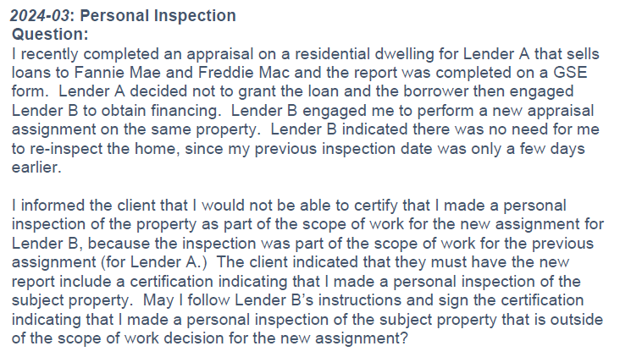
Part 3: Changes to USPAP—Definitions
Page 44

Slide 84
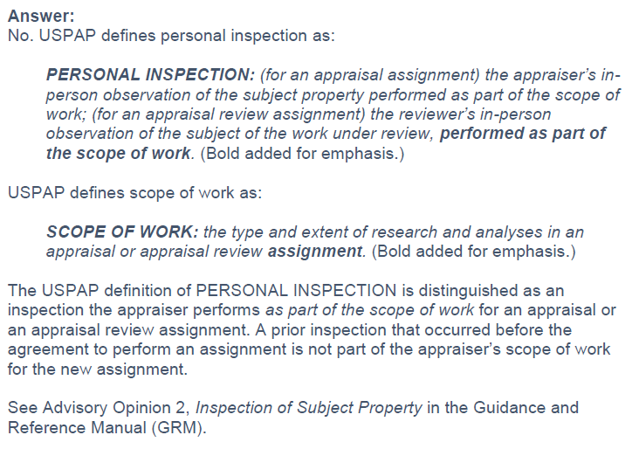
Part 3: Changes to USPAP—Definitions
Page 44

Slide 85
Part 3: Changes to USPAP—Definitions
Page 45
Modified Definition
Personal Inspection
Exercise #11:
What Constitutes a Personal Inspection

Slide 86
Part 3: Changes to USPAP—Definitions
Page 46
Modified Definitions
Workfile
Rationale for Modification
Key Elements of Definition
Impact on Practice

Slide 87

Changes to Standard Rules: “Sales and Other Transfers”

Slide 88
Part 3: Changes to USPAP— STANDARD RULES: “Sales and Other Transfers”
Page 47
To eliminate confusion, “and other transfers” added to following Standard Rules:
Standards Rule 1-5(b) | Standards Rule 8-2(a)(x)(3)
Standards Rule 2-2(a)(x)(3) | Standards Rule 8-2(b)(xii)(3)
Standards Rule 2-2(b)(xii)(3) | Standards Rule 9-4(b)
Standards Rule 7-5(b)

Slide 89
Part 3: Changes to USPAP— STANDARD RULES: “Sales and Other Transfers”
Page 47
Rationale for Modification
Key Elements of Definition
Impact on Practice

Slide 90

Minor Edits

Slide 91
Part 3: Changes to USPAP— Minor Edits
Page 48
Replacing the words “a summary” with “the description” in the Comment in the certification requirements for:
Standards Rule 2-3(c)(ii) | Standards Rule 8-3(c)(ii)
Standards Rule 4-3(c)(ii) | Standards Rule 10-3(c)(ii)
Standards Rule 6-3(c)(ii)

Slide 92
Part 3: Changes to USPAP— Minor Edits
Page 48
Change to STANDARD 6
Adds “in writing” to clarify that oral report is not an option for Mass Appraisal

Slide 93
Part 3: Changes to USPAP— Minor Edits
Page 49
Change to Standards Rule 8-2
Words added to make internally consistent

Slide 94
Case Studies
Part 4:

Slide 95
Instructions for Case Studies
Page 51
Five case studies
Each case study contains intentionally vague background details
Hint words provided to help find the solutions

Slide 96
Procedures for Solving Case Studies
Page 51
In small groups search USPAP and the USPAP GRM to either:
Identify where to find information in the publications that supports the possible scenario
or
Identify where to find information in the USPAP publication that indicates the possible scenario is incorrect
Jot down assumptions and conclusions, relevant parts of USPAP and the guidance to support or refute the possible scenario

Slide 97
Let’s Get Started!
Read the background details
Locate evidence to support or refute these possible scenarios
Use the Reference Index to aid with your search
Use the USPAP publication that is current for the date you are taking this course.

Slide 98
Case Study A: Oral Appraisal Reports

Slide 99
Case Study A: Oral Appraisal Reports
Page 52
Hint words or phrases to search for:
assignment results
report
oral report
certification

Slide 100
Case Study B: Personal Inspection

Slide 101
Case Study B: Personal Inspection
Page 53
Hint words or phrases to search for:
certification
personal inspection
physical inspection
significant appraisal assistance
significant real property appraisal assistance

Slide 102

Case Study C: Extraordinary Assumption

Slide 103
Case Study C: Extraordinary Assumption
Pages 54
Hint words or phrases to search for:
extraordinary assumptions
as-is value
labeling extraordinary assumptions
reasonable basis
when may an extraordinary assumption be used

Slide 104
Case Study D: Advocacy

Slide 105
Case Study D: Advocacy
Pages 55
Hint words or phrases to search for:
advocate
valuation service

Slide 106

Case Study D: Discounting

Slide 107
Case Study E: Discounting
Page 56
Hint words or phrases to search for:
assemblage
deductions and discounts
unsold units
sum

Slide 108
THANK YOU
Communicating with the Foundation and its Boards is easy
www.appraisalfoundation.org
1155 15th Street NW, Suite 1111 Washington, DC 20005 202.347.7722
info@appraisalfoundation.org AQB@appraisalfoundation.org ASB@appraisalfoundation.org

